Slide 1
Customer Segmentation
Here we are working for develop a customer segmentation to define marketing strategy.
Segmentation in marketing is a technique used to divide customers or other entities into groups based on attributes such as behaviour or demographics .
It is useful to identify segments of customers who may respond in a similar way to specific marketing techniques such as email subject lines or display advertisements. As it gives businesses the ability to tailor marketing messages and timing to generate better response rates and provide improved consumer experiences.

Slide 2
KPIs
Key performance indicators (KPIs) refer to a set of quantifiable measurements used to gauge a company's overall long-term performance. KPIs specifically help determine a company's strategic, financial, and operational achievements, especially compared to those of other businesses within the same sector.
Here we are finding Monthly average purchase and cash advance amount
Purchases by type (one-off, installments)
Average amount per purchase and cash advance transaction,
Limit usage (balance to credit limit ratio),
Payments to minimum payments ratio etc (think of more types of similar analysis)

Slide 3
Case Study
In our data installment frequency is highly negatively correlated to cash advance frequency .
Credit limit is almost positively correlated with everything .
Balance of the customers are highly positively correlated to payments , cash advance , credit limits byt highly negatively correlated to % of months with full payments due balance .
Purchases are highly positively correlated to credit limits & payments .
Purchase frequency is highly negative with respect to cash advance frequency .

Slide 4
We can see all this in our correlation matrix heat map I.e how one feature is correlated with the other feature .

Slide 5
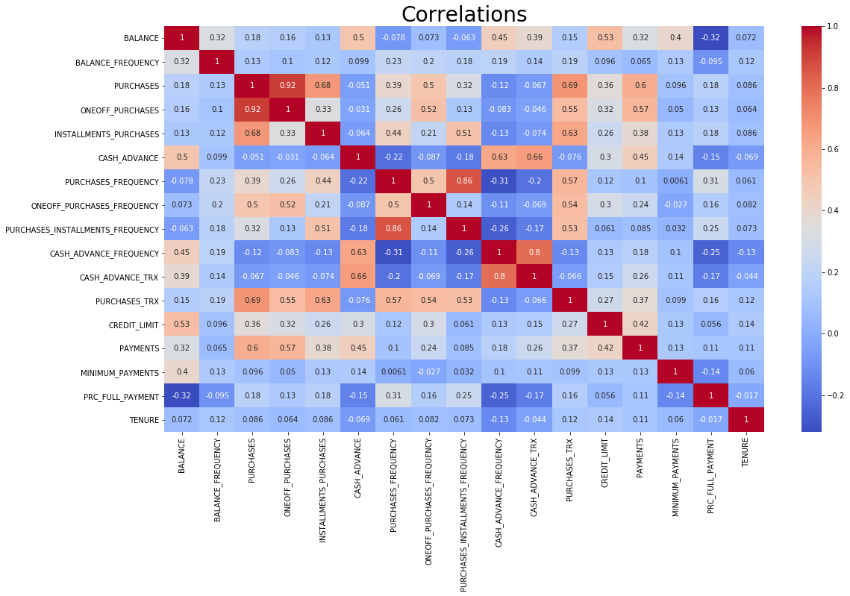
Our correlation heat map with respect to each features

Slide 6
After finding K-mean clustering we got that the optimal K value is 2 I.e
Optimal k = 2 .
Also optimal k from the elbow method came out to be 10. Therefore 10 clusters were formed

Slide 7
